Slide 1
INFO 5100 Fall 2025 Final Project
Pet Care Ecosystem 🐾
Group: Group 1
Team members: Linyao Han, Jing Yang Wang, Hairui Dou
Date: December 8, 2025

Slide 2
Problem & Motivation
Unpredictable accidents or illness
Rising pet medical costs
Manual insurance processes
Need for efficiency and accuracy

Slide 3
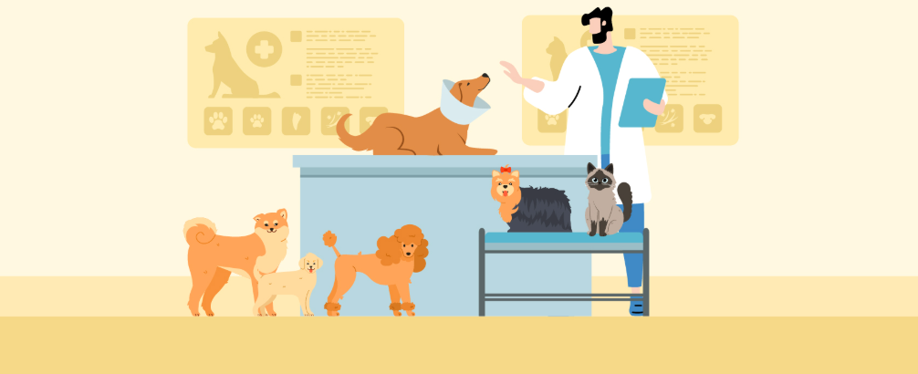
Enterprise Directory
Pet Boarding Enterprise (PetCareTaker, BoardingManager, CustomerSupporter)
Pet Clinic Enterprise (FrontDesk,VetDoctor, VetLabAssistant)
Pet Insurance Enterprise (ClaimProcessor, InsuranceAgent)

Slide 4
Pet Boarding Enterprise 🐾
🙋 Pet Care Taker Organization
-Role: Pet Care Taker
-Main Functions:
Register for new boarding services.
Record the daily care of pets.
Send a request to the manager for unusual pets.
🧑‍️Manger Organization
-Role: Manager
-Main Functions:
Receive Pet Care Taker Request
Send a Request to Customer Service for
unusual pets.
👩 Customer service Organization
-Role: Lab Assistant Customer service
-Main Functions:
Contatct the pet's owner.
Receive information about insurance and the clinic

Slide 5
Workflows involved 🐾
☘️Health Care Check Request
Sender: Pet CareTaker (PetBoarding)
Receiver: Front Desk (PetClinic)
Operation:
pet boarding PetCareTaker→
Pet clinic FrontDesk
💉 Health Care Check Request
Sender: Vet Doctor (PetClinic) and ClaimProcessor(insurance)
Receiver: Customer Service (Pet boarding)
Operation:
Pet Clinic Vet Doctor and pet Insurance Claim Processor→ Pet Boarding Customer Service

Slide 6
Pet Clinic Enterprise 🐾
🙋 Front Desk Organization
-Role: Front Desk
-Main Functions:
Receive Health Care Check Request
Assign doctors
Receive Lab Test Result
Send Insurance Claim Request
🧑‍ Vet Doctor Organization
-Role: Doctor
-Main Functions:
Receive Health Care Check Request
Send Lab Test Request
Give treatment needed
👩 Vet Lab Organization
-Role: Lab Assistant
-Main Functions:
Complete Lab Test received

Slide 7
Workflows involved 🐾
☘️Health Care Check Request
Sender: Pet CareTaker (PetBoarding)
Receiver: Front Desk (PetClinic)
Operation:
Issue Health Care Check Requests (PetCareTaker) →
Receive Health Care Check Requests (FrontDesk) →
Related to Lab Test Request + Treatment Needed→ Issue Insurance Cliam Request (FrontDesk)
💉 Health Care Check Request
Sender: Vet Doctor (PetClinic)
Receiver: Lab Assistant (PetClinic)
Operation:
Issue Lab Test Request(Doctor)→
Complete the Test(LabAssistant)→
Give Treatment Needed(Doctor)→
Give result to the Health Care Check Request

Slide 8

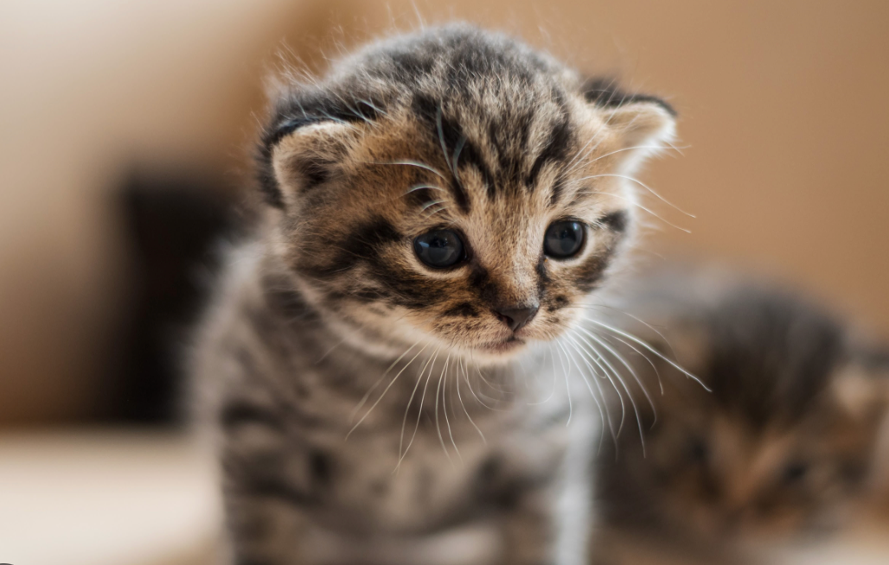
Workflows involved 🐾
💼 Insurance Claim Request
Sender: FrontDesk(PetClinic)
Receiver: ClaimProcessor (PetInsurance)
Operation:
Issue Insurance Claim Request(FrontDesk)→
Give Decision(ClaimProcessor)→
Update Insurance Cliam Result(FrontDesk)

Slide 9
Pet Insurance Enterprise 🐾
📋 Insurance Policy Organization
Role: Insurance Agent
Main Functions:
Create New Policy
View Policy Details
Manage Policy Details
View Insurance Overview
🧮 Insurance Claim Organization
Role: Claim Processor
Main Functions:
View Claim Details
Modify Claim Details
Search Policy Record
Approve/Reject Claim
Send Compensation

Slide 10
Workflows involved 🐾
Insurance Claim Request
Sender: Front Desk (PetClinic)
Receiver: ClaimProcessor
Operation:
Submit Insurance Claim Requests (FrontDesk) →
Receive New Claims (ClaimProcessor) →
Manage Claims Status (ClaimProcessor) →
Receive Claim Results (Doctor)
Compensation Notification Request
Sender: ClaimProcessor
Receiver: CustomerService(PetBoarding)
Operation:
Receive New Claims (ClaimProcessor) →
Determine Claim Amount (ClaimProcessor) →
Send Compensation (ClaimProcessor) →
Receive Compensation Results (CustomerService)

Slide 11
Conclusion 🐾
Reduced manual processing and improved efficiency
Delivered a clear, intuitive UI for all user roles
Enabled faster decisions and better service for pet owners

